Slide 1
Turing Machine

Slide 2
Formal Definitions

Slide 3
Definition of Turing Machine
A Turing Machine (TM) is a 5-tuple T=( Q , Σ , Γ , q_{o} , δ )
Where
Q : finite se of states
(assumed not contain h_{a} or h_{r} , two halting state)
Σ : finite set of input alphabets
Γ : finite set of tape alphabets
(assume not contain Δ, the blank symbol)
q_{o} : initial state
(element of Q)
δ : transition function
Q×(Γ ∪ {Δ}) → (Q ∪ { h_{a} , h_{r} }) ×(Γ ∪ {Δ}) × { R , L , S }

Slide 4
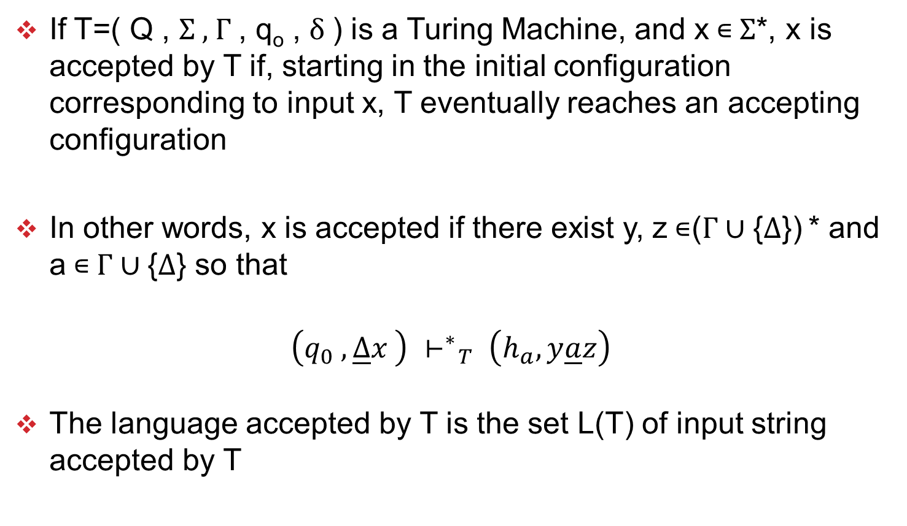
Accepted by TM
If T=( Q , Σ , Γ , q_{o} , δ ) is a Turing Machine, and x ∊ Σ*, x is accepted by T if, starting in the initial configuration corresponding to input x, T eventually reaches an accepting configuration
In other words, x is accepted if there exist y, z ∊(Γ ∪ {Δ}) * and a ∊ Γ ∪ {Δ} so that
$$\left(q_{0} , \underline{∆}x \right) {⊢^{∗}}_{T} \left(h_{a},y\underline{a}z\right)$$
The language accepted by T is the set L(T) of input string accepted by T

Slide 5
basics

Slide 6
Compare FA,PDA,TM
Accept
All Languages
TM
Accept
All Context Free Languages
(All Regular + Some Non-regular)
PDA
FA
Accept
All Regular Languages

Slide 7
Compare FA,PDA,TM
 | Accepted by
 | FA | PDA | TM
Regular languages e.g. a*b* | ✓ | ✓ | ✓
Context free languages e.g. a^{n}b^{n} | × | ✓ | ✓
Recursively enumerable languages e.g. a^{n}b^{n}c^{n} | × | × | ✓
 | FA | PDA | TM
Memory | Finite memory | Stack | Tape

Slide 8
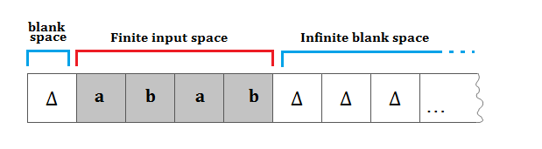
Basic of TM
TM as infinite tape, divided into cells
Tape has two parts
  Finite input space
  Infinity blank space
tape

Slide 9
Basic of TM
Head is pointed to one element of tape
Once symbol have been read from current location
  Head can move on Right side of current location (R)
  Head can move on Left side of current location (L)
  Head remains on current location (S)
depends on application
Head

Slide 10
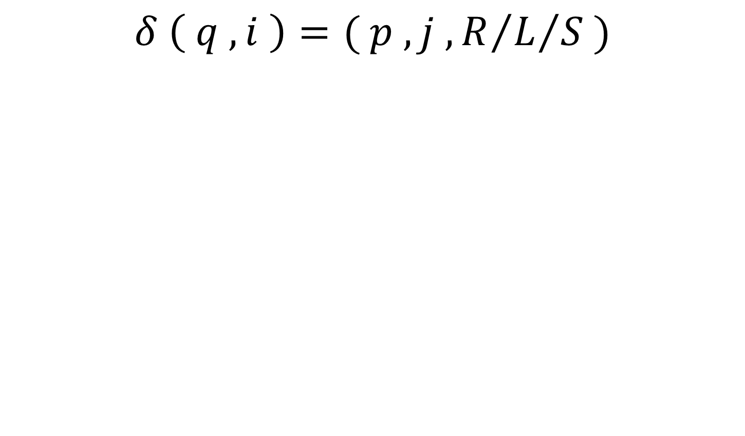
δ for TM
$$δ \left( q , i \right)=( p , j , R/{L/S )}$$
Current
state
Next
state
Next
Move
Right (R)
Left (L)
Nothing (S)
Input symbol
on tape on
Current position
Of head
Symbol to be write
on tape on
Current position
Of head

Slide 11
TM used as
Accepting device
  Takes input string and accept it or reject it
Input-output device
  Takes input string and generates output string

Slide 12
Examples

Slide 13
EX-1 : { a , b }* a b a { a , b }*
It’s a regular language
So can be accepted by FA , PDA , TM all
Let first construct FA
b
a,b
a
q0
a
q1
b
q2
a
q3
b

Slide 14
EX-1 : { a , b }* a b a { a , b }*
Now try to construct TM for this
Logic
  Read all symbol from the tape
  Need to search “aba” substring
  So skip all “b” at initial level
  Once “a” encounter, skip other “a” and search for “b”
  “b” encounter the search for next “a”
  But if “b” comes then again search fro patter “aba”
  Once you search patter “aba” go to halt state
  No need to do process rest of the symbols

Slide 15
EX-1 : { a , b }* a b a { a , b }*
b|b,R
a|a,R
∆|∆,R
a|a,R
b|b,R
a|a,R
q0
q1
q2
q3
h_{a}
b|b,R

Slide 16
EX-2 : { a , b }* a b a
It’s a regular language
So can be accepted by FA , PDA , TM all
Let first construct FA
a
a
b
q0
a
q1
b
q2
a
q3
b
b

Slide 17
EX-2 : { a , b }* a b a
Now try to construct TM for this
Logic
  String must end with “aba”
  So need to process entire string till reach to blank (Δ)
  Once you reach to black (Δ) go to halt state

Slide 18
EX-2 : { a , b }* a b a
a|a,R
b|b,R
a|a,R
q0
Δ|Δ,R
q1
a|a,R
q2
b|b,R
q3
a|a,R
q4
Δ|Δ,R
h_{a}
b|b,R
b|b,R

Slide 19
EX-3 : palindrome
Not a regular language
So cannot be accepted by FA
Direct construct TM
Situation of tape will be as follow

Slide 20
EX-3 : palindrome
Logic
  Read blank (Δ) on 0th location
  On 1st location input starts
  It may be “a” or “b”
  Consider the case for starting with “a” and do same for starting with “b”

Slide 21
EX-3 : palindrome
Logic
  Starting with “a” then read “a” and replace it with blank (Δ)
  Skip all “a” and “b” move Right till you encounter blank (Δ) (end of string)
  Come one step Left
  if it is “b” then string must be rejected, reach to Halt State of Rejection (h_{r}) (But this rejection transition is optional)
  if it is “a” then replace it with blank (Δ) and “a”-”a” matched
  Move Left till encounter blank (Δ) (beginning of string)
  Do same process till encounter blank (Δ) after blank (Δ)
  Then reach to Halt state of Acceptance (h_{a})

Slide 22
EX-3 : palindrome
Δ
a
b
b
a
Δ
Δ
Δ
b
b
a
Δ
Δ
a
b
b
a
Δ
Δ
Δ
b
b
a
Δ
Δ
Δ
b
b
a
Δ
Δ
Δ
b
b
Δ
Δ
Δ
Δ
b
b
a
Δ
Δ
Δ
b
b
Δ
Δ
Δ
Δ
b
b
a
Δ
Δ
Δ
b
b
Δ
Δ

Slide 23
EX-3 : palindrome
Δ
Δ
b
b
Δ
Δ
Δ
Δ
Δ
Δ
Δ
Δ
Δ
Δ
Δ
b
Δ
Δ
HALT
(Accepted)
Δ
Δ
Δ
b
Δ
Δ
Δ
Δ
Δ
b
Δ
Δ
Δ
Δ
Δ
Δ
Δ
Δ

Slide 24
EX-3 : palindrome
a|a,R
All other remain as it is
Odd length string
Middle char is ‘a’
b|b,R
Δ|Δ,L
Move left for 2nd char
Till other remain as it is
q2
q3
Δ|Δ,R
First symbol ‘a’
Last symbol ‘a’
b|b,L
a|Δ,R
a|Δ,L
a|a,L
Δ|Δ,R
Δ|Δ,R
q0
q1
q4
h_{a}
b|Δ,R
b|Δ,L
Last symbol ‘b’
First symbol ‘b’
q5
Δ|Δ,L
q6
Δ|Δ,R
Odd length string
Middle char is ‘b’
All other remain as it is
a|a,R
Even length string
b|b,R
Δ|Δ,R

Slide 25
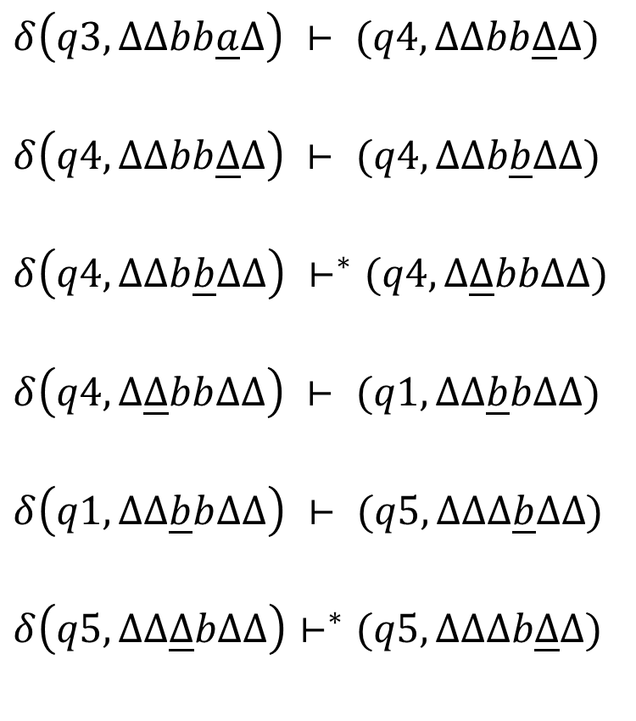
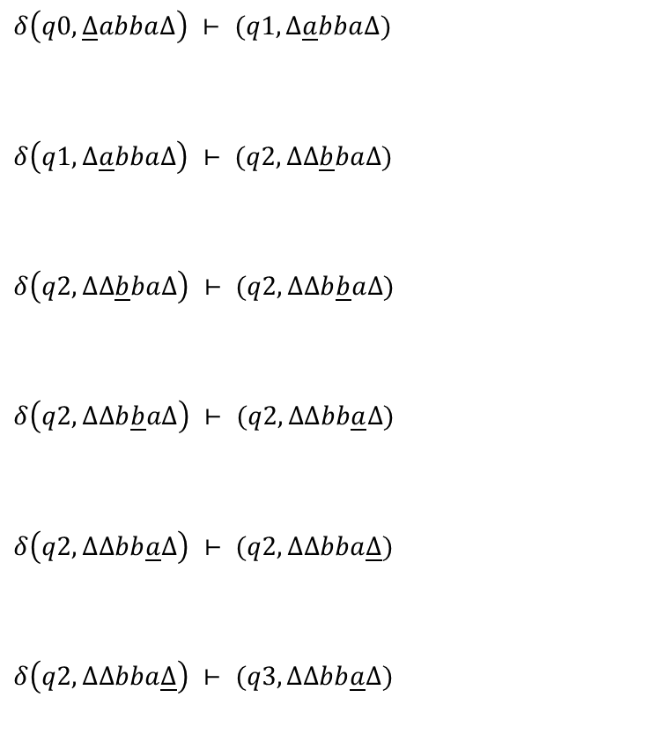
EX-3 : palindrome
$$δ\left(q0, \underline{Δ}abba∆\right) ⊢ (q1,Δ\underline{a}bba∆)$$
$$δ\left(q1, ∆\underline{a}bba∆\right) ⊢ (q2,Δ∆\underline{b}ba∆)$$
$$δ\left(q2, ∆∆\underline{b}ba∆\right) ⊢ (q2,Δ∆b\underline{b}a∆)$$
$$δ\left(q2, ∆∆b\underline{b}a∆\right) ⊢ (q2,Δ∆bb\underline{a}∆)$$
$$δ\left(q2, ∆∆bb\underline{a}∆\right) ⊢ (q2,Δ∆bba\underline{∆})$$
$$δ\left(q2,Δ∆bba\underline{∆}\right) ⊢ (q3,Δ∆bb\underline{a}∆)$$
$$δ\left(q3,Δ∆bb\underline{a}∆\right) ⊢ (q4,Δ∆bb\underline{∆}∆)$$
$$δ\left(q4,Δ∆bb\underline{∆}∆\right) ⊢ (q4,Δ∆b\underline{b}∆∆)$$
$$δ\left(q4,Δ∆b\underline{b}∆∆\right) ⊢^{∗}(q4,Δ\underline{∆}bb∆∆)$$
$$δ\left(q4,Δ\underline{∆}bb∆∆\right) ⊢ (q1,Δ∆\underline{b}b∆∆)$$
$$δ\left(q1,Δ∆\underline{b}b∆∆\right) ⊢ (q5,Δ∆∆\underline{b}∆∆)$$
$$δ\left(q5,Δ∆\underline{∆}b∆∆\right)⊢^{∗}(q5,Δ∆∆b\underline{∆}∆)$$

Slide 26
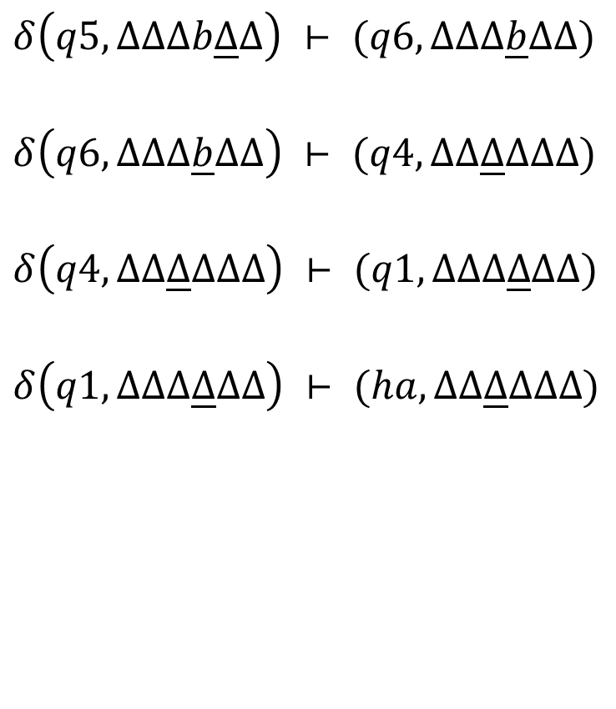
EX-3 : palindrome
$$δ\left(q5,Δ∆∆b\underline{∆}∆\right) ⊢ (q6,Δ∆∆\underline{b}∆∆)$$
$$δ\left(q6,Δ∆∆\underline{b}∆∆\right) ⊢ (q4,Δ∆\underline{∆}∆∆∆)$$
$$δ\left(q4,Δ∆\underline{∆}∆∆∆\right) ⊢ (q1,Δ∆Δ\underline{∆}∆∆)$$
$$δ\left(q1,Δ∆Δ\underline{∆}∆∆\right) ⊢ (ha,Δ∆\underline{∆}Δ∆∆)$$
HALT
(Accepted)

Slide 27
EX-4 : { ss | s ∊ {a,b}* }
Logic
  Need to find middle point of string
  From both ends convert “a” to “A” and “b” to “B”
  When from L and R side of head you find Uppercase letter mean head reach to middle point
  Once arrive at middle(if string is of even length), convert symbols of first half to Lowercase again
  Take one Lowercase letter from first half of starting, compare to Uppercase letter from second half of string
  To keep track of processing, convert Lowercase letter to Uppercase letter & replace Uppercase letter with blank (Δ)

Slide 28
EX-4 : { ss | s ∊ {a,b}* }
Δ
a
b
a
b
Δ
Δ
A
b
a
b
Δ
Δ
a
b
a
b
Δ
Δ
A
b
a
B
Δ
Δ
A
b
a
b
Δ
Δ
A
b
a
B
Δ
Δ
A
b
a
b
Δ
Δ
A
b
a
B
Δ
Δ
A
b
a
b
Δ
Δ
A
b
a
B
Δ
Δ
A
b
a
b
Δ
Δ
A
B
a
B
Δ

Slide 29
EX-4 : { ss | s ∊ {a,b}* }
Δ
A
B
a
B
Δ
Δ
a
b
A
B
Δ
Δ
A
B
a
B
Δ
Δ
a
b
A
B
Δ
Δ
A
B
A
B
Δ
Δ
A
b
A
B
Δ
Δ
A
B
A
B
Δ
Δ
A
b
A
B
Δ
Δ
A
B
A
B
Δ
Δ
A
b
Δ
B
Δ
Δ
A
b
A
B
Δ
Δ
A
b
Δ
B
Δ

Slide 30
EX-4 : { ss | s ∊ {a,b}* }
Δ
A
b
Δ
B
Δ
Δ
A
B
Δ
Δ
Δ
Δ
A
B
Δ
B
Δ
HALT
(Accepted)
Δ
A
B
Δ
B
Δ
Δ
A
B
Δ
Δ
Δ
Δ
A
B
Δ
Δ
Δ
Δ
A
B
Δ
Δ
Δ

Slide 31
EX-4 : { ss | s ∊ {a,b}* }
B|B,R A|A,R
Δ|Δ,R
q0
a|A,R
b|B,R
Δ|Δ,L
B|B,L
A|A,L
a|A,L
b|B,L
q1
q2
q3
q4
a|a,L
b|b,L
Δ|Δ,S
A|A,L
B|B,L
B|b,L
A|a,L
q5
b|b,R
h_{a}
a|a,R
Δ|Δ,R
Δ|Δ,S
q6
b|B,R
a|A,R
a|a,R
b|b,R
Δ|Δ,R
a|a,R
b|b,R
Δ|Δ,R
q8
A|A,R
B|B,R
q7
B|Δ,L
A|Δ,L
q9
b|b,L a|a,L
Δ|Δ,L

Slide 32
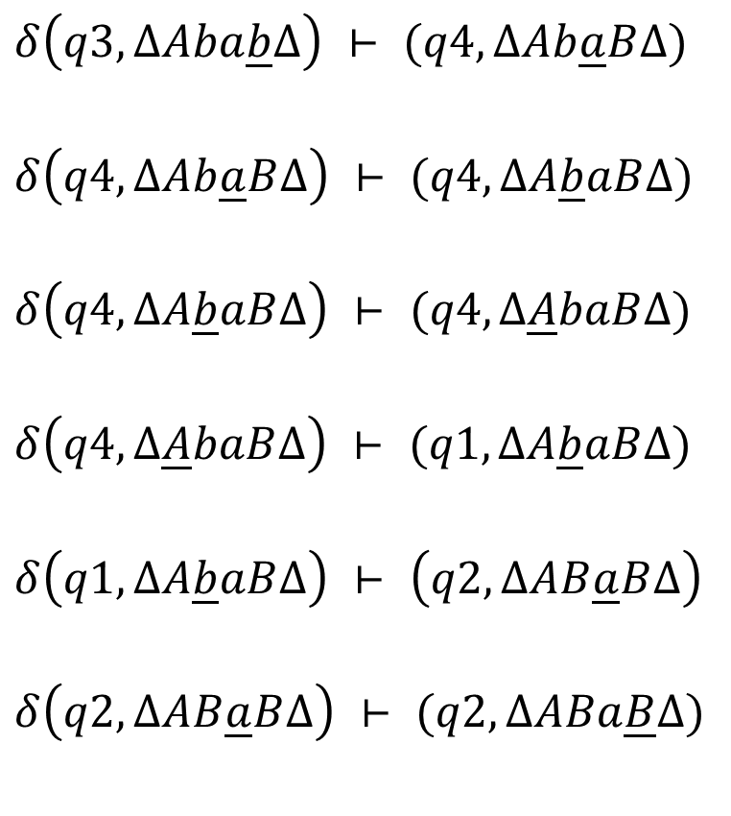
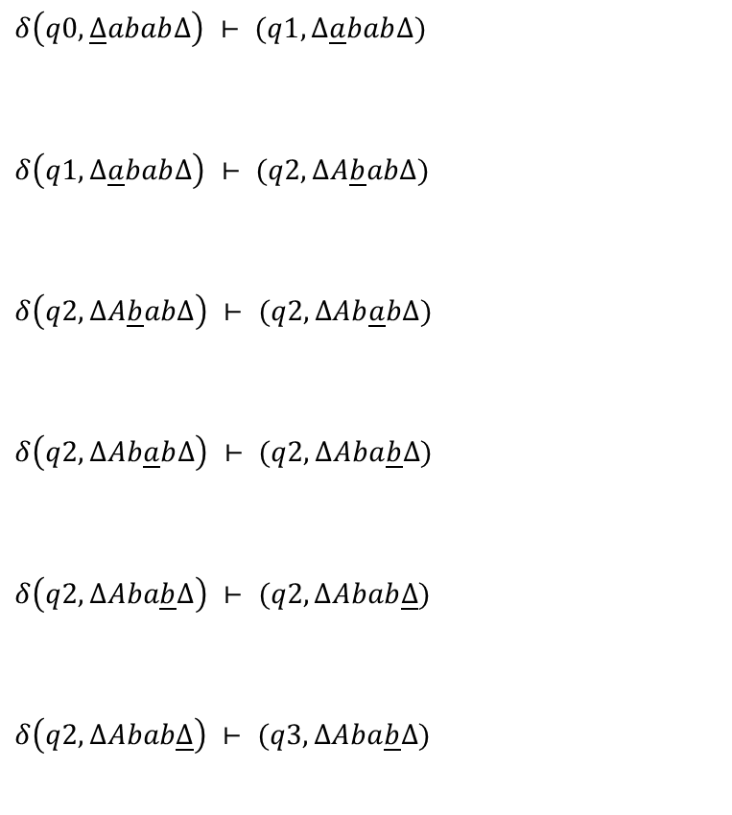
EX-4 : { ss | s ∊ {a,b}* }
$$δ\left(q0, \underline{Δ}abab∆\right) ⊢ (q1,∆\underline{a}bab∆)$$
$$δ\left(q1,∆\underline{a}bab∆\right) ⊢ (q2,∆A\underline{b}ab∆)$$
$$δ\left(q2,∆A\underline{b}ab∆\right) ⊢ (q2,∆Ab\underline{a}b∆)$$
$$δ\left(q2,∆Ab\underline{a}b∆\right) ⊢ (q2,∆Aba\underline{b}∆)$$
$$δ\left(q2,∆Aba\underline{b}∆\right) ⊢ (q2,∆Abab\underline{∆})$$
$$δ\left(q2,∆Abab\underline{∆}\right) ⊢ (q3,∆Aba\underline{b}∆)$$
$$δ\left(q3,∆Aba\underline{b}∆\right) ⊢ (q4,∆Ab\underline{a}B∆)$$
$$δ\left(q4,∆Ab\underline{a}B∆\right) ⊢ (q4,∆A\underline{b}aB∆)$$
$$δ\left(q4,∆A\underline{b}aB∆\right) ⊢ (q4,∆\underline{A}baB∆)$$
$$δ\left(q4,∆\underline{A}baB∆\right) ⊢ (q1,∆A\underline{b}aB∆)$$
$$δ\left(q1,∆A\underline{b}aB∆\right) ⊢ \left(q2,∆AB\underline{a}B∆\right)$$
$$δ\left(q2,∆AB\underline{a}B∆\right) ⊢ (q2,∆ABa\underline{B}∆)$$

Slide 33
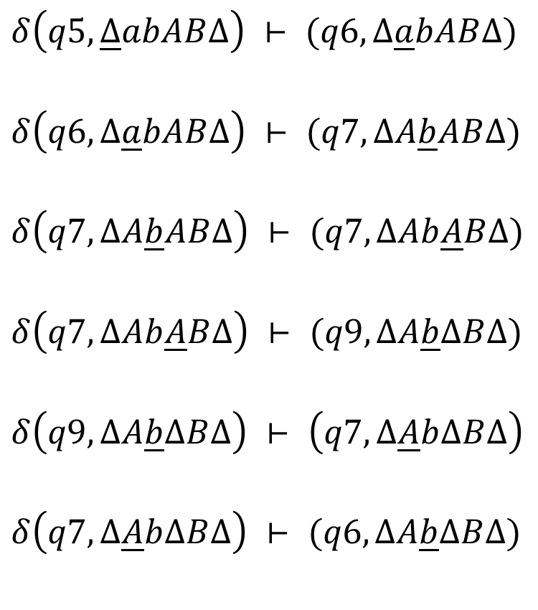
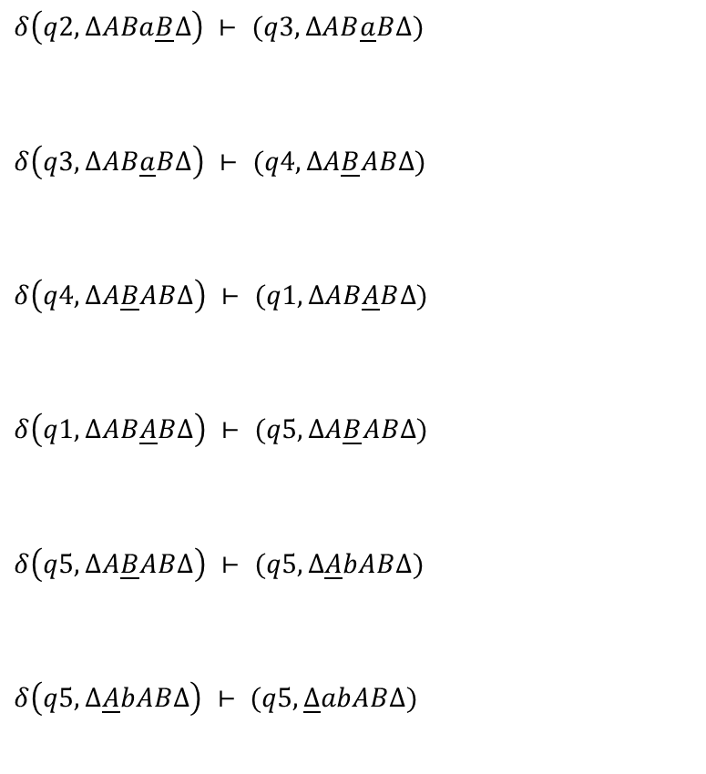
EX-4 : { ss | s ∊ {a,b}* }
$$δ\left(q2,∆ABa\underline{B}∆\right) ⊢ (q3,∆AB\underline{a}B∆)$$
$$δ\left(q3,∆AB\underline{a}B∆\right) ⊢ (q4,∆A\underline{B}AB∆)$$
$$δ\left(q4,∆A\underline{B}AB∆\right) ⊢ (q1,∆AB\underline{A}B∆)$$
$$δ\left(q1,∆AB\underline{A}B∆\right) ⊢ (q5,∆A\underline{B}AB∆)$$
$$δ\left(q5,∆A\underline{B}AB∆\right) ⊢ (q5,∆\underline{A}bAB∆)$$
$$δ\left(q5,∆\underline{A}bAB∆\right) ⊢ (q5,\underline{∆}abAB∆)$$
$$δ\left(q5,\underline{∆}abAB∆\right) ⊢ (q6,∆\underline{a}bAB∆)$$
$$δ\left(q6,∆\underline{a}bAB∆\right) ⊢ (q7,∆A\underline{b}AB∆)$$
$$δ\left(q7,∆A\underline{b}AB∆\right) ⊢ (q7,∆Ab\underline{A}B∆)$$
$$δ\left(q7,∆Ab\underline{A}B∆\right) ⊢ (q9,∆A\underline{b}∆B∆)$$
$$δ\left(q9,∆A\underline{b}∆B∆\right) ⊢ \left(q7,∆\underline{A}b∆B∆\right)$$
$$δ\left(q7,∆\underline{A}b∆B∆\right) ⊢ (q6,∆A\underline{b}∆B∆)$$

Slide 34
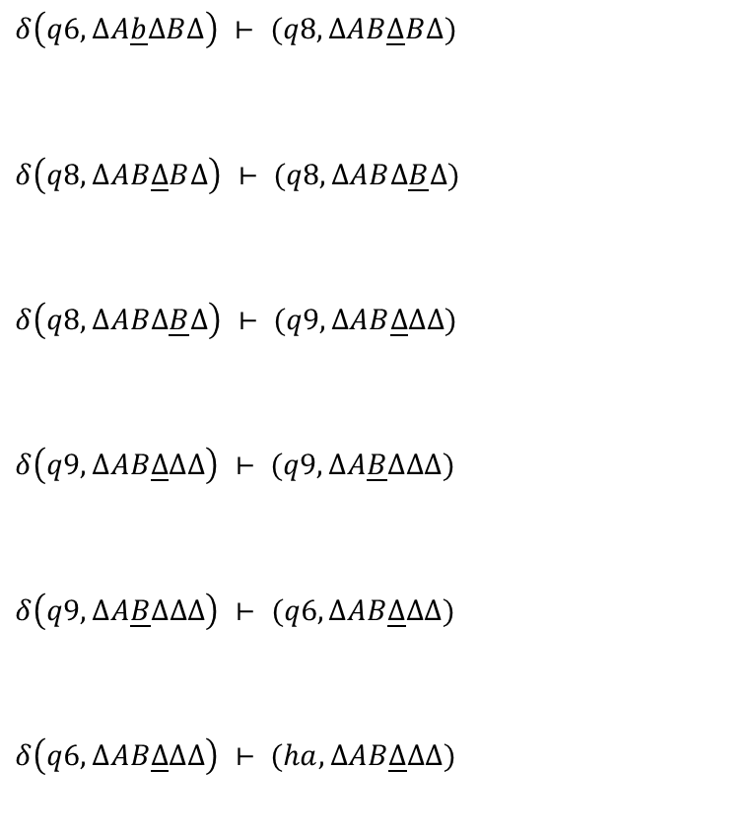
EX-4 : { ss | s ∊ {a,b}* }
$$δ\left(q6,∆A\underline{b}∆B∆\right) ⊢ (q8,∆AB\underline{∆}B∆)$$
$$δ\left(q8,∆AB\underline{∆}B∆\right) ⊢ (q8,∆AB∆\underline{B}∆)$$
$$δ\left(q8,∆AB∆\underline{B}∆\right) ⊢ (q9,∆AB\underline{∆}∆∆)$$
$$δ\left(q9,∆AB\underline{∆}∆∆\right) ⊢ (q9,∆A\underline{B}∆∆∆)$$
$$δ\left(q9,∆A\underline{B}∆∆∆\right) ⊢ (q6,∆AB\underline{∆}∆∆)$$
$$δ\left(q6,∆AB\underline{∆}∆∆\right) ⊢ (ha,∆AB\underline{∆}∆∆)$$
HALT (Accepted)

Slide 35
EX-5 : n mod 2
Odd 1’s
Generate 1
at first location
1|1,R
1|Δ,L
q0
Δ |Δ,R
q1
Δ |Δ,L
q2
q3
Δ |Δ,R
q4
Δ |1,L
h_{a}
1|Δ,L
Even 1’s
Generate Δ
at first location
Δ |Δ,S

Slide 36
EX-5 : n mod 2
Input
Output
Δ | 1 | 1 | 1 | 1 | Δ | Δ | . . .
Δ | Δ | Δ | Δ | Δ | Δ | Δ | . . .
Even times 1
Output is ΔΔ at beginning
Δ | 1 | 1 | 1 | Δ | Δ | Δ | . . .
Δ | 1 | Δ | Δ | Δ | Δ | Δ | . . .
Odd times 1
Output is Δ1 at beginning

Slide 37
EX-6 : Reversing string
A|A,R
B|A,R
Δ|Δ,L
A|A,L
B|B,L
a|a,R
b|b,R
q3
a|A,L
q2
q6
A|A,R
B|B,R
a|a,L
b|b,L
a|A,R
B|B,R
A|A,R
b|A,L
q0
Δ|Δ,R
q1
q8
Δ |Δ,L
Δ |Δ,L
A|A,R
B|B,R
h_{a}
Δ|Δ,S
q9
a|a,L
b|b,L
b|B,R
A|A,R
B|B,R
a|B,L
A|a,L
B|b,L
q7
q4
b|B,L
q5
Δ|Δ,L
A|A,L
B|B,L
a|a,R
b|b,R
A|B,R
B|B,R

Slide 38
EX-6 : Reversing string
Input
Output
Δ | a | b | a | a | Δ | Δ | . . .
Δ | a | a | b | a | Δ | Δ | . . .

Slide 39
EX-7 : Deleting a symbol
a|a,L
a|a,R
b|b,R
qa
a|Δ,L
Δ| Δ,S
q0
Δ|Δ,R
q1
Δ|Δ,L
qΔ
h_{a}
b|a,L
a|b,L
b|Δ,L
Δ| Δ,S
qb
b|b,L
Δ|Δ,S

Slide 40
EX-7 : Deleting a symbol
Input
Output
Δ | a | b | a | a | Δ | Δ | . . .
Δ | b | a | a | Δ | Δ | Δ | . . .

Slide 41
EX-8 : Copying a string
aIa,R
b|b,R
aIa,R
b|b,R
q2
ΔIΔ,R
q3
aIa,L
b|b,L
aIa,L
b|b,L
aIA,R
ΔIa,L
q0
ΔIΔ,R
q1
aIa,R
b|b,R
q4
ΔIΔ,L
q7
bIB,R
ΔIb,L
q5
ΔIΔ,R
q6
ΔIΔ,L
aIa,R
b|b,R
AIA,R
B|B,R
ha
ΔIΔ,S
q8
AIa,L
B|b,L

Slide 42
EX-8 : Copying a string
Input
Δ | a | b | a | a | Δ | Δ | Δ | Δ | Δ | Δ | Δ | . . .
Output
Δ | a | b | a | a | Δ | a | b | a | a | Δ | Δ | . . .

Slide 43
EX-9 : Unary to Binary conversion
x|x,R
1|x,R
x|x,R
q0
1|1,R
q1
Δ|Δ,L
x|x,L
A|A,R
B|B,R
Δ|Δ,L
1|1,L
x|x,L
a|a,L
b|b,L
1|1,L
x|x,L
a|a,L
b|b,L
q4
Δ|A,R
q3
Δ|B,R
q2
Δ|Δ,S
1|x,R
h_{a}

Slide 44
EX-9 : Unary to Binary conversion
Input
Δ | a | b | a | a | Δ | Δ | Δ | Δ | Δ | Δ | Δ | . . .
Output
Δ | a | b | a | a | Δ | a | b | a | a | Δ | Δ | . . .

Slide 45
EX-10 : Parenthesis balancing
( | ( , R
x | x, R
) | x , L
x | x , L
q0
Δ | Δ , R
q1
q2
( | x , R
Δ | Δ , L
q3
Δ | Δ , S
h_{a}
x | x , L

Slide 46
EX-11 : Parity checking
0|x,R
0|x,R
1|x,R
q0
Δ | Δ , R
q1
q2
1|x,R
Δ|E,S
Δ|O,S
h_{a}

Slide 47
EX-12 : Inserting a symbol
a|a,R
qa
a|x,R
Δ|a,S
Δ| Δ,R
q0
q1
b|a,R
a|b,R
h_{a}
b|x,R
Δ|b,S
qb
b|b,R

Slide 48
Combining
Turing machines

Slide 49
Combining Turing Machines
T₁ and T₂ are two TMs and T_{c} is composition of them
T₁ executes first then T₂ will execute
T₁, T₂ and T_{c} are sharing common tape and tape head
T₁ end position of head in tape is same as T₂ start position of head in tape
T_{c} = T₁T₂
Head end position after process of T₁
Head start position for process of T₂

Slide 50



Combining Turing Machines
$$T_{1}= \left\{Q_{1},Σ,Γ,q_{10},δ \right\}$$
$$T_{c}= \left\{Q_{1},Σ,Γ,q_{10},δ \right\}$$
$$T_{2}= \left\{Q_{2},Σ,Γ,q_{20},δ \right\}$$
q₁₀
h_{a}
q₂₀
h_{a}
q₁₀
h_{a}
q₂₀
h_{a}

Slide 51
Universal
Turing Machine

Slide 52
Basics
If a Turing machine is created to execute a specific algorithm then computing a different function requires a different machine
Universal Turing machine (UTM) can simulate an arbitrary Turing machine on arbitrary input
The universal machine essentially achieves this by reading two things
  Description of the machine to be simulated
  Input from its own tape

Slide 53
Notational System
Arbitrary TM T₁
Input string z
Encode both as e(T₁) and e(z)
encoding must be one-to-one
and must not destroy any information
means reconstruction of T₁ and z must possible
Assign positive integers to each state, each tape symbol and each direction (R, L, S)

